Slide 1
A Model for Single-Phase Migration of Trenton-Black River Hydrocarbon in the Southern Michigan Basin
--Ron DeHaas & Timothy Brock

Slide 2
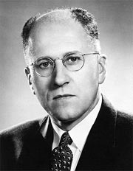
William Carruthers Gussow
1908 - 2005

Slide 3
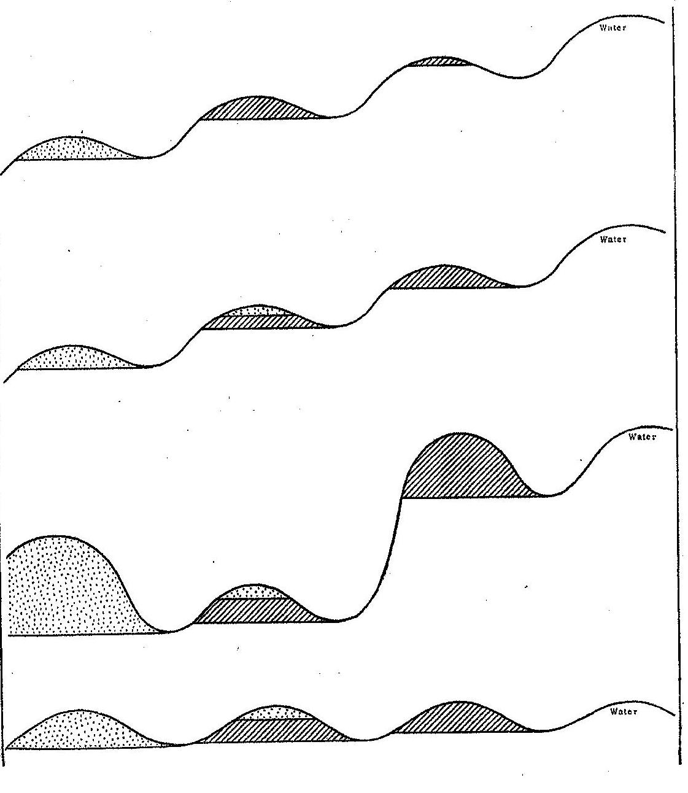

Differential Migration of Hydrocarbon
OIL
UPDIP HYDROCARBON MIGRATION
GAS
GAS/OIL
OIL
WATER

Slide 4
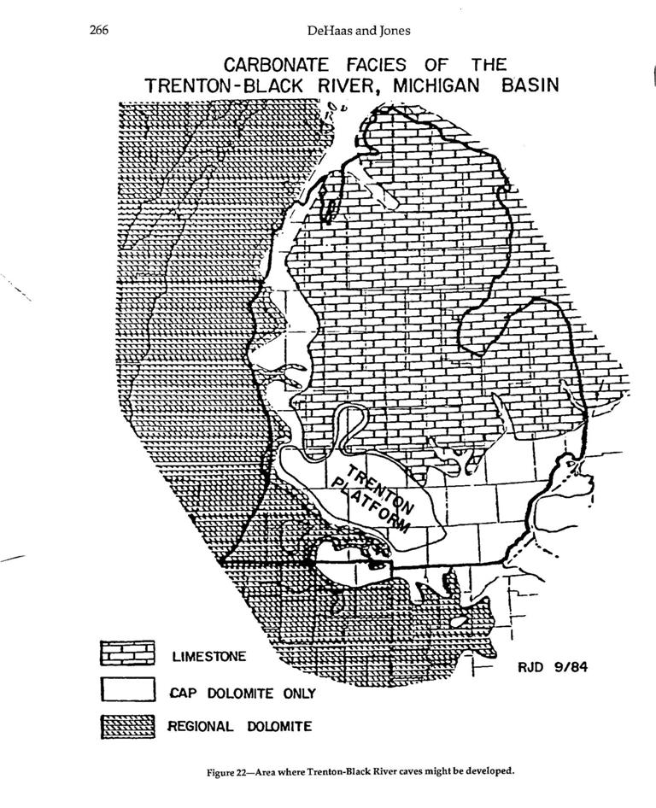

Slide 5
Empire State Building
(1930’s Plumbing)

Slide 6
Empire State Building
(1930’s Plumbing)

Slide 7
Empire State Building
(1950’s Plumbing)

Slide 8
Empire State Building
(1980’s Plumbing)

Slide 9
Empire State Building (1980’s Plumbing) turned on its side to illustrate complexity of Trenton-Black River reservoirs in central southern Michigan

Slide 10

So…
IN LIGHT OF DIFFERENTIAL ENTRAPMENT,
WHY IS THERE A GAS CAP IN ALL OF THE TRENTON-BLACK RIVER RESERVOIRS?
MAYBE ALL OF THE HYDROCARBON
MIGRATED AS A SINGLE LIQUID PHASE?!?

Slide 11
How much pressure would it take to
homogenize Trenton-Black River
oil and gas?
Where would that pressure come from?

Slide 12
Evidence for deeper burial
Cercone, Karen Rose, 1984, AAPG Bull. v. 68 no. 2 (February, 1984), pp. 130-136:
"Sediment accumulation rates, regional dips, and maturity of Pennsylvanian-age coals suggests that up to 1000 m (3,280 ft) of sediment were removed by erosion...“
Rullkotter, Jurgen, et al., 1986, Org. Geochem. v. 10, pp. 359-375:
“We agree with the conclusion of Cercone… Calculations using kinetic parameters of steroid reactions indicate that oil generation in the Michigan basin requires deeper subsidence of the source rocks in the geological past..."

Slide 13
ASSUMPTIONS FOR
HOMOGENIZATION MODEL
Original Albion-Scipio Discovery BHP 1823 psia
Pre-erosion additional overburden 1000 m.
Pre-erosion additional pressure of 1500 psia
1823 Albion-Scipio
+1500 Additional
= 3323 psia original
Complete homogenization (single liquid oil phase) with a bubble point of 3323 psia
Discovery pressure of Stoney Point = 1529 psia

Slide 14
With those assumptions:
What would have happened as the 1000’ of overburden was stripped away?
What would be the ratio of gas cap pore volume to oil column pore volume (“m”) at the time of Albion-Scipio discovery?
What would that ratio “m” be at the time of Stoney Point discovery?
Does that match up with known data?
What else could we expect?

Slide 15
Theoretical line using known Trenton-Black River oil and gas characteristics,

Slide 16
The predicted “m” value for
Stoney Point is 0.38
Does that match up with known data??

Slide 18
What else would we expect to see if the hydrocarbon migrated as a single liquid oil phase?

Slide 19
Preferential concentration of nitrogen
in gas cap, but not in solution gas
Perched oil in the gas cap
Perched water in the oil column

Slide 21
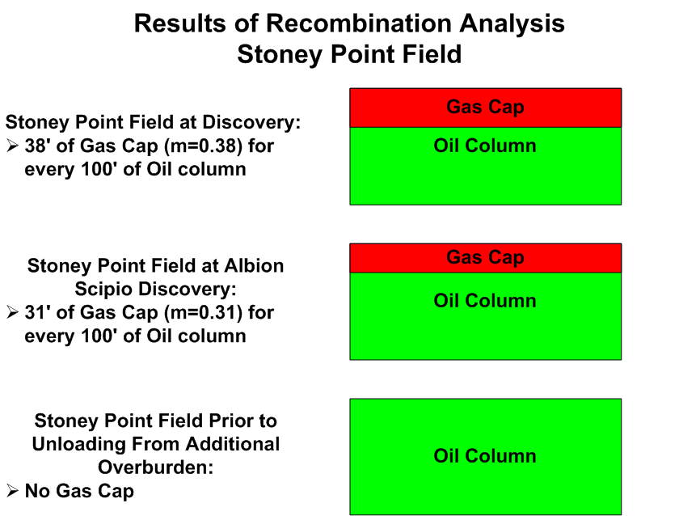

Slide 22
CONCLUSION:
Single liquid oil phase migration of
Trenton-Black River oil is consistent with other data (Cercone, 1984), and further explains:
- ubiquitous gas caps in Trenton-Black River
- high nitrogen content in gas cap
- perched oil in the gas cap
- perched water in the oil column
To view again, visit rjdehaas.com/singlephase

